Slide 1
Interactive Visual
Data Analysis
10 – Basic picking, selection, and zooming

Slide 2
Objectives
How can we identify data and interface items on the display: Learn concepts and strategies of fundamental picking
How can relevant information be emphasized in a visual representation: Learn about selection and accentuation

Slide 3
Overview
Today: Basic techniques
  Fundamental picking
  Interactive selection and accentuation
  Navigating zoomable visualizations
Next lectures: Advanced techniques

Slide 4
Motivation
We learned about interaction intents in Lecture 9.
Interaction intents (Yi et al., 2007)
Fundamental picking, interactive selection, and accentuation
  Mark something as interesting
  Show me something conditionally
Navigating zoomable visualizations
  Show me something else
  Show me more or less detail

Slide 5
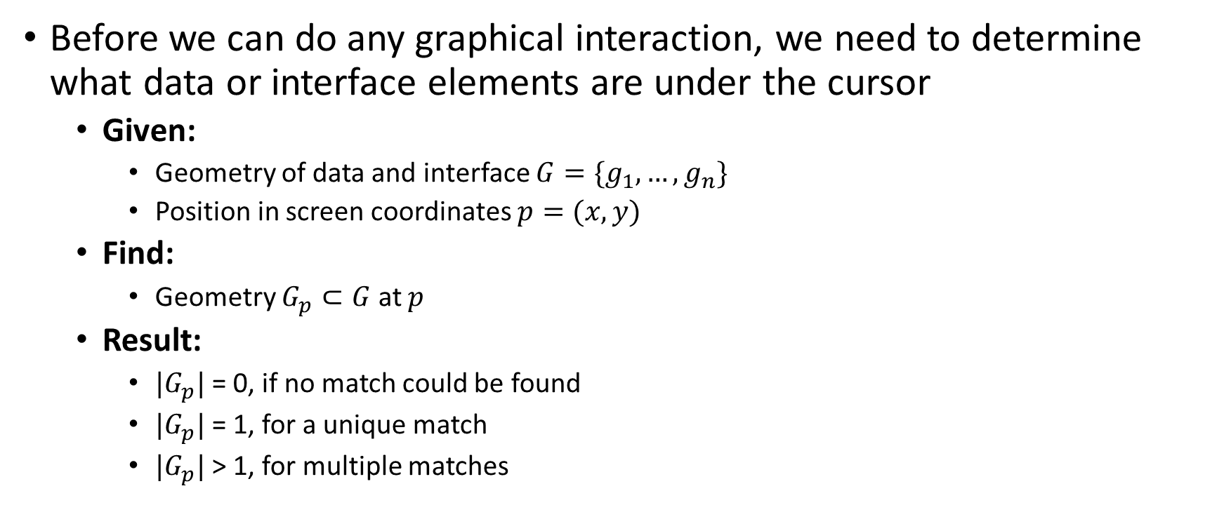
Fundamental picking
Before we can do any graphical interaction, we need to determine what data or interface elements are under the cursor
  Given:
    Geometry of data and interface $G=\{g_{1},…, g_{n}\}$
    Position in screen coordinates $p=(x,y)$
  Find:
    Geometry $G_{p}⊂G$ at $p$
  Result:
    $|G_{p}|$= 0, if no match could be found
    $|G_{p}|$= 1, for a unique match
    $|G_{p}|$> 1, for multiple matches

Slide 6
Fundamental picking
Key problem when picking data elements
  Inverse mapping of visual representation
  to data (not always a unique solution)
  Picking must be as fast as possible to
  reduce temporal separation
Implementation possible at different stages of visualization pipeline
  Pixel picking at the image stage
  Geometry picking at the geometry stage
  Direct picking at the mapping stage
We discussed temporal separation in Lecture 9.

Slide 7
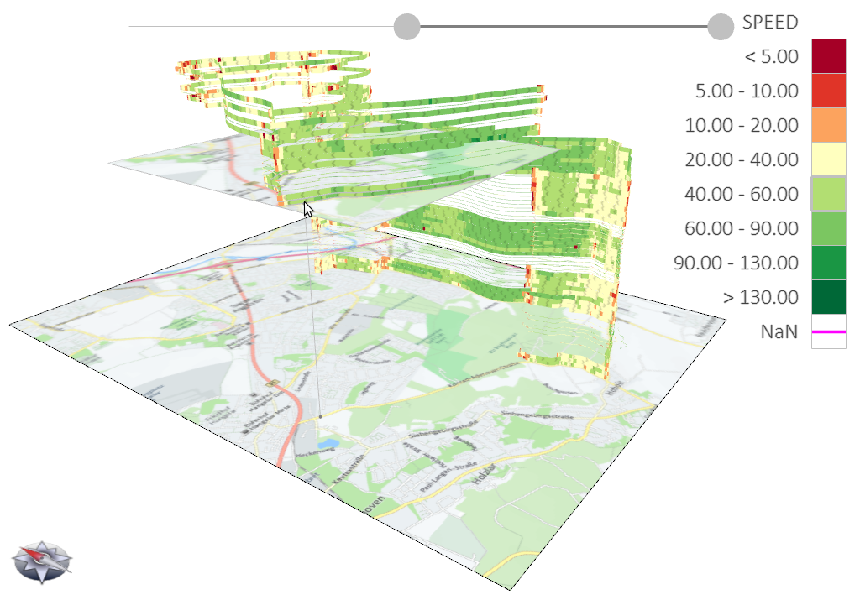
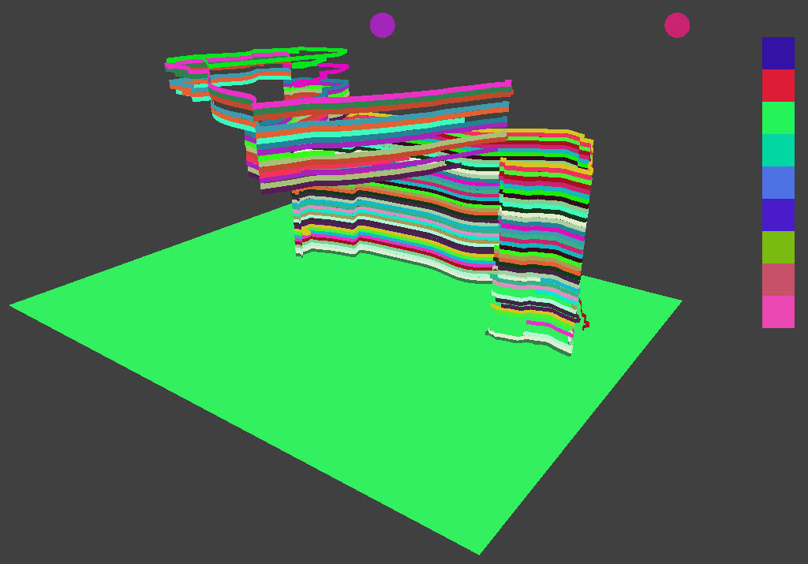

Fundamental picking
Pixel picking
Render visualization twice
  Color buffer: regular visualization colors
  Picking buffer: object ids as pseudo colors
Picking is then a simple constant-time
lookup in the picking buffer → $O(1)$
Think about: What can we learn from
the two example buffers?
Color buffer
Picking buffer
Notes:
Picking buffer indicates which graphical elements are relevant for interaction
There is difference between what is rendered for visualization and interaction
It makes sense to conceptually distinguish the display view (visualization) from the picking view (interaction)
(see “Model-Display view-Picking view-Controller (MDPC) concept by Conversy, 2011, https://doi.org/10.1109/VLHCC.2011.6070392)

Slide 8
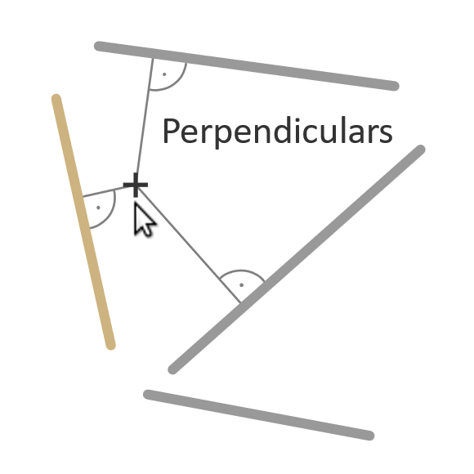
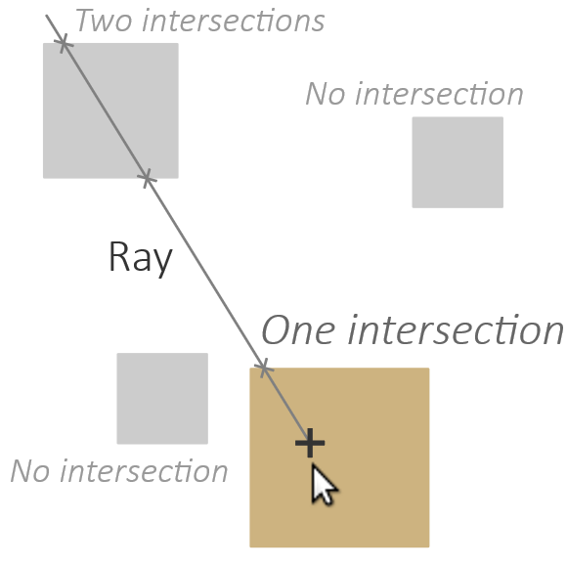
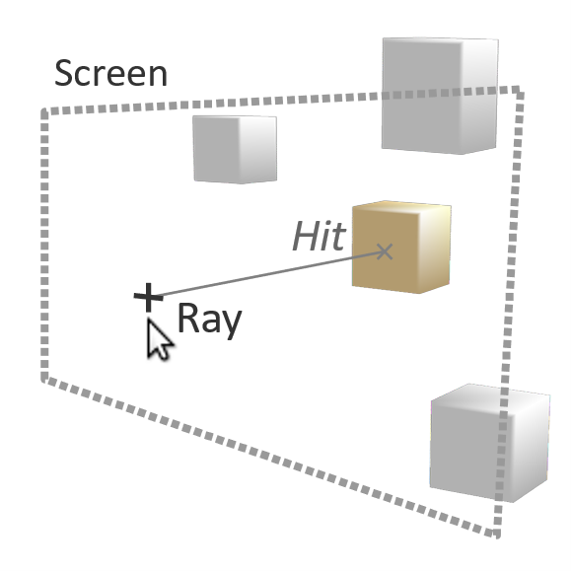

Fundamental picking
Geometry picking
Geometric tests depending on geometry to pick → $O(n)$
If accelerated with spatial data structures (e.g., grids, R-trees) → $O(log⁡n)$
Nearest-neighbor search for 0D/1D Inclusion test for 2D Ray intersection for 3D

Slide 9
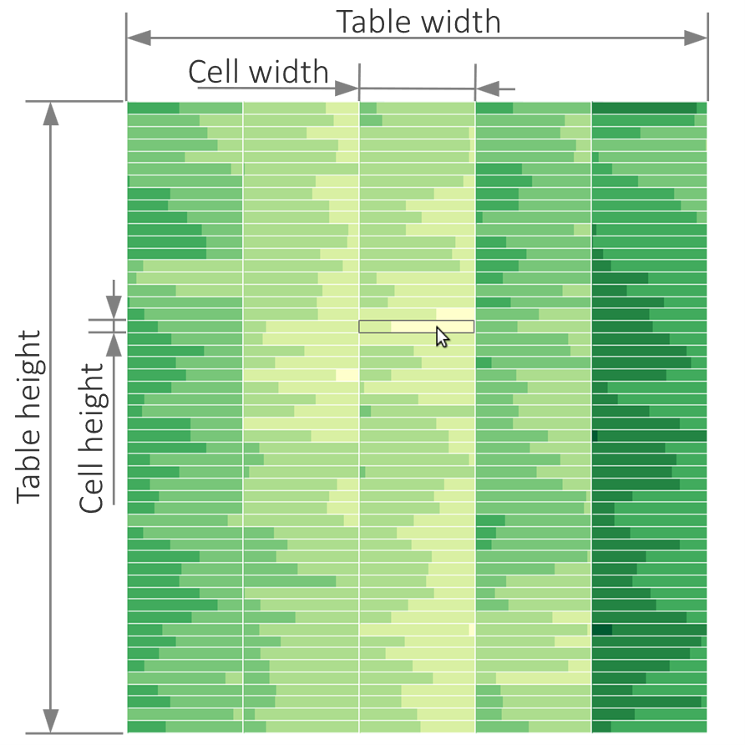
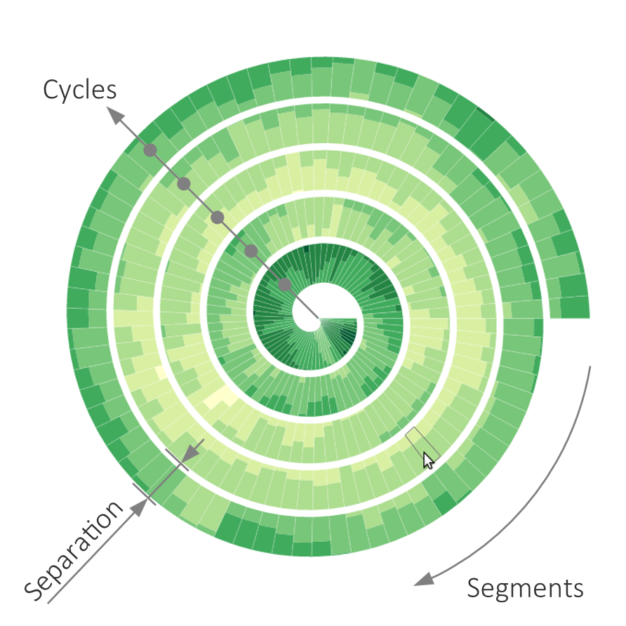
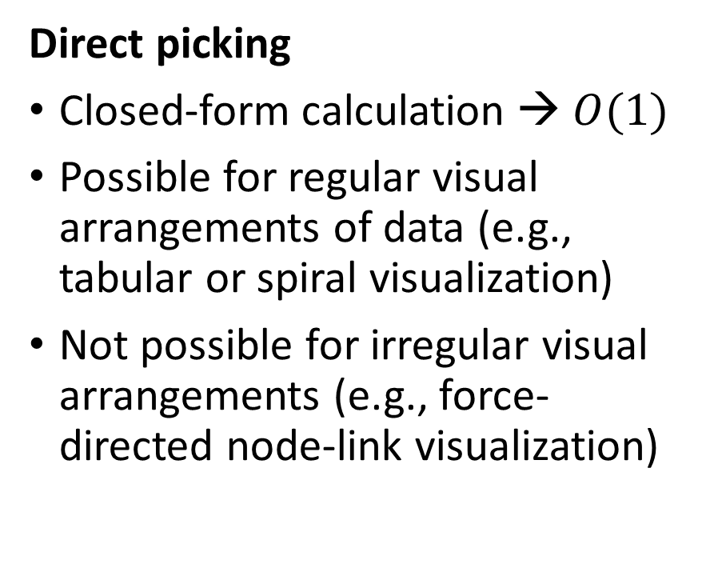
Fundamental picking
Direct picking
Closed-form calculation → $O(1)$
Possible for regular visual arrangements of data (e.g., tabular or spiral visualization)
Not possible for irregular visual arrangements (e.g., force-directed node-link visualization)

Slide 10
Fundamental picking
function pick(table, x, y) {
// Compute cell height and width
let cell_height = table.height / table.rows;
let cell_width = table.width / table.columns;
// Compute row and column at (x, y)
let row = Math.floor(y / cell_height);
let col = Math.floor(x / cell_width);
return [row, col];
}
Direct picking
Picking segments
from a table

Slide 11
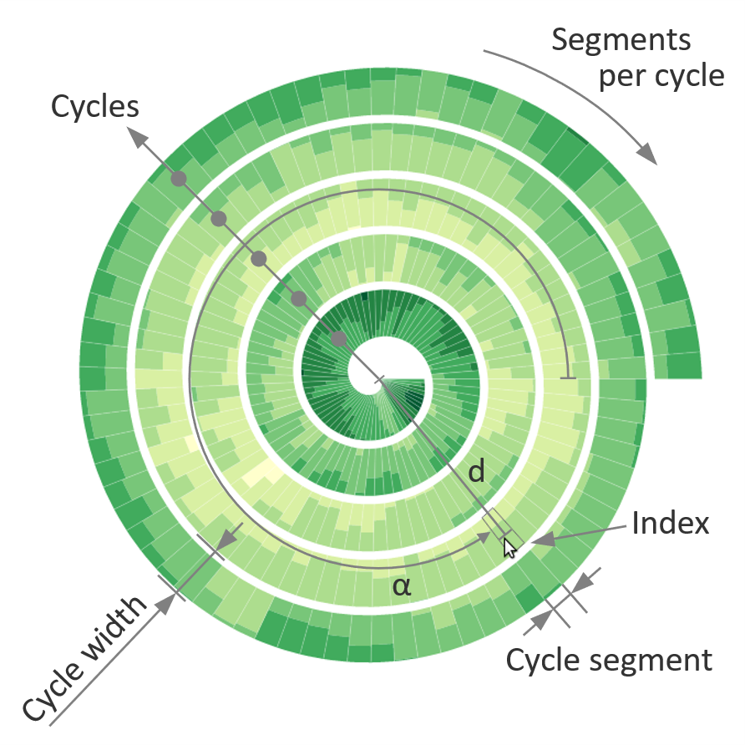
Fundamental picking
In Lecture 6, we learned how to draw such a spiral.
function pick(spiral, x, y) {
// Compute angle α in range [-PI .. PI]
let α = Math.atan2(y, x);
// Map negative angles from [-PI .. 0] to [PI .. 2*PI]
if (α < 0) α += 2 * PI;
// Normalize angle α to from [0 .. 2*PI] to [0 .. 1]
α /= 2 * PI;
// Determine the segment at angle α
let cycle_segment = Math.floor(α * spiral.segments_per_cycle);
// Distance d from spiral center
let d = Math.sqrt(x * x + y * y);
// Subtract fraction of the cycle width at angle α
d -= α * spiral.cycle_width;
// Normalize distance to [0 .. 1]
d /= spiral.radius;
// Cycle at distance d (+ 1 accounts for extent of spiral band)
let cycle = Math.floor(d * (spiral.cycles + 1));
let index = cycle_segment + cycle * spiral.segments_per_cycle;
return index;
}
Direct picking
Picking segments
from a spiral

Slide 12
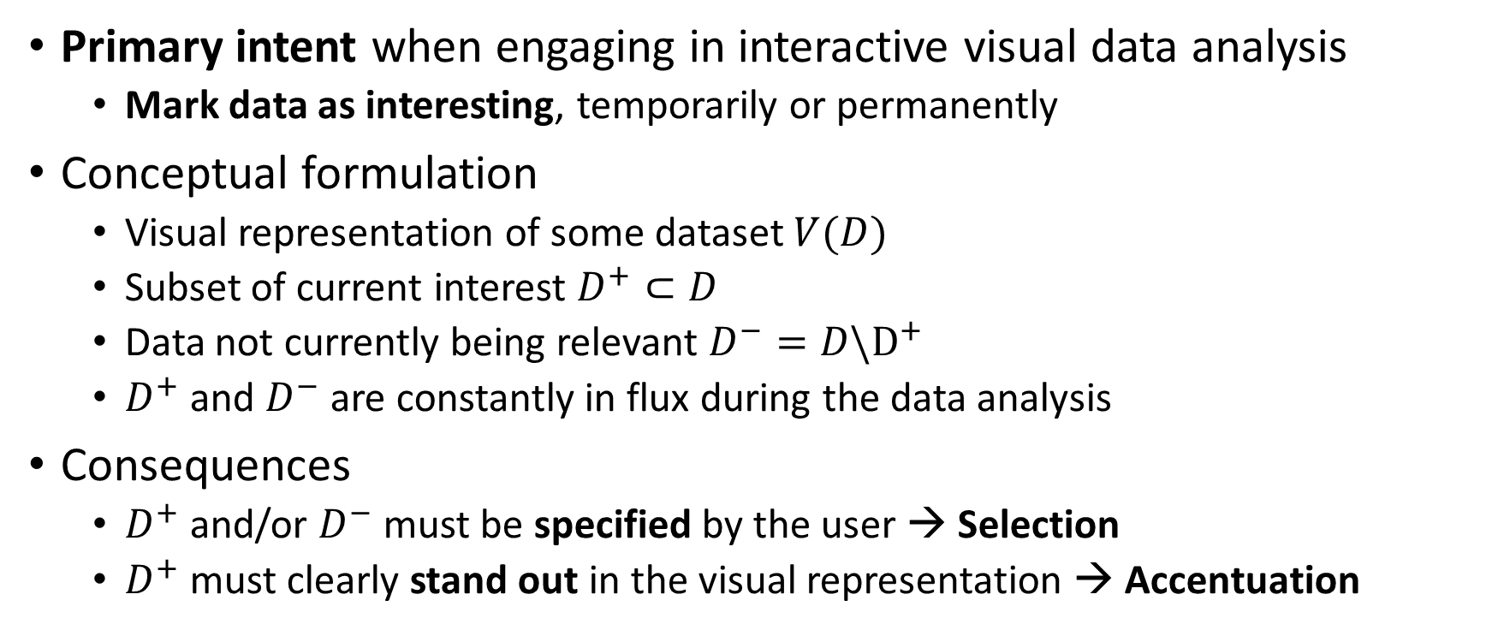
Interactive selection and accentuation
Primary intent when engaging in interactive visual data analysis
  Mark data as interesting, temporarily or permanently
Conceptual formulation
  Visual representation of some dataset $V(D)$
  Subset of current interest $D^{+}⊂D$
  Data not currently being relevant $D^{−}=D\backslash D^{+}$
  $D^{+}$ and $D^{−}$ are constantly in flux during the data analysis
Consequences
  $D^{+}$ and/or $D^{−}$ must be specified by the user → Selection
  $D^{+}$ must clearly stand out in the visual representation → Accentuation

Slide 13
Interactive selection
Question: How can users specify their interest?
Basic methods:
  Select based data’s screen location:
  Mark something → Interactive brushing
  Select based data’s attributes:
  Define conditions → Dynamic querying
Both, interactive brushing and dynamic querying should be supported, because either alone is usually not sufficient for all user needs

Slide 14
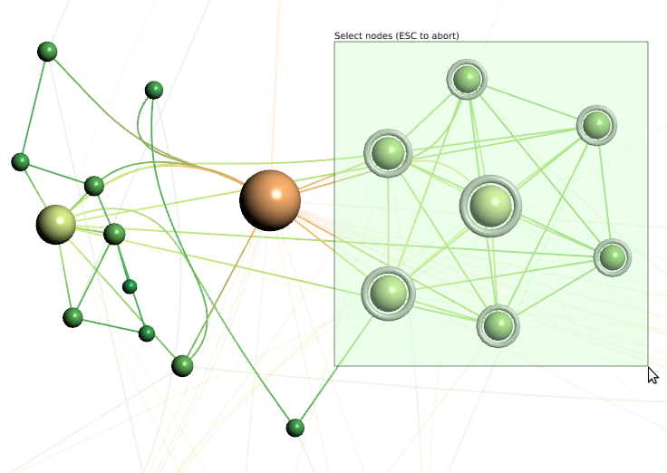
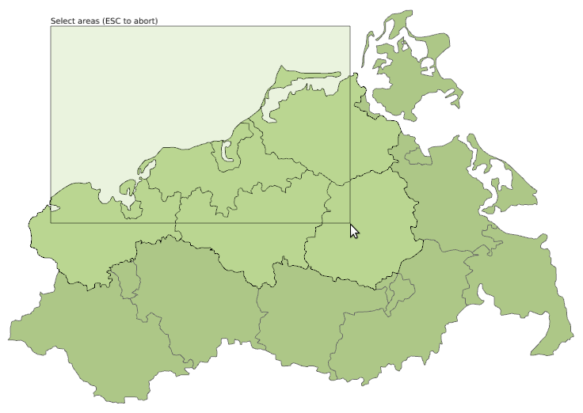
Interactive selection
Data elements must be included in rubberband in order to be selected
Interactive brushing
Point selection
  Utilize basic picking for discrete picking of individual data elements
Range selection
  Rubberband or lasso selection
  Variants: Inclusion or intersection
  Think about: What are pros and cons of rubberband and lasso selection and its variants?
Data elements need to intersect with the rubberband in order to be selected

Slide 15
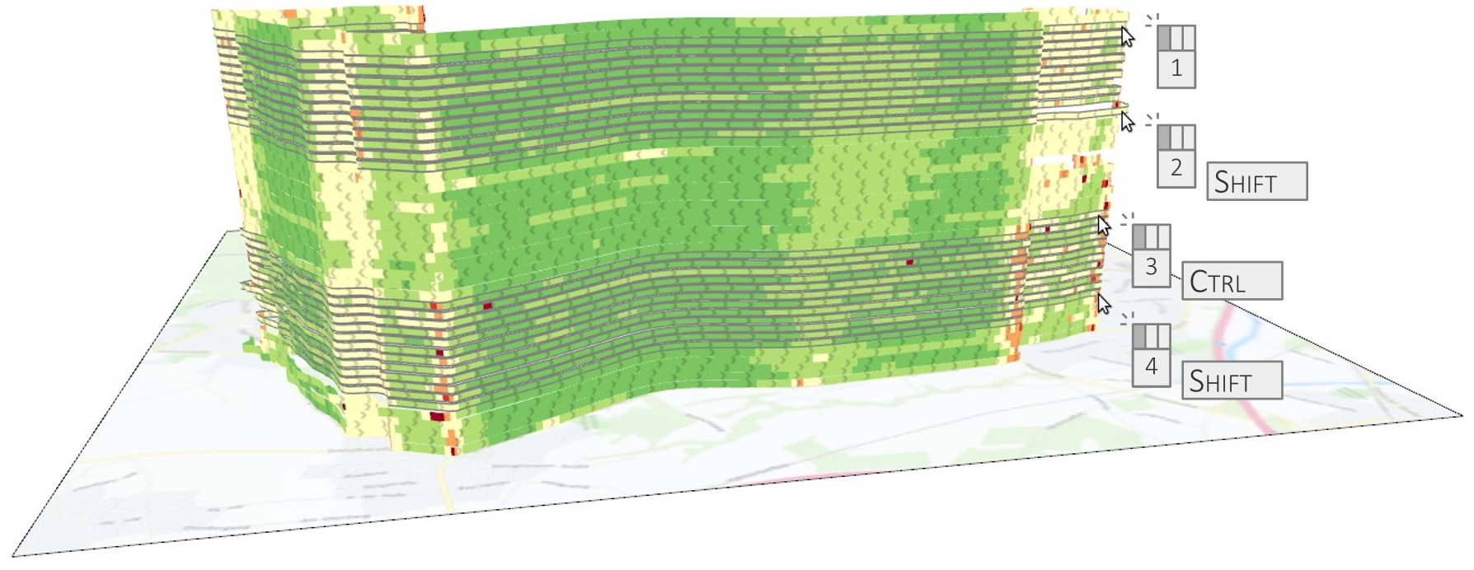
Interactive selection
Interactive brushing
Composite selection
  How to combine multiple selections
  Theoretically, 524.288 possible combinations of add, remove, subtract, intersect, union operations
  (Wills, 1996)
  Today rather standard
    CTRL modifier: Toggle selection state
    SHIFT modifier: Select multiple items
    Combine modifiers for complex selections
Creating a composite selection of trajectories using modifier keys

Slide 16
Interactive selection
Dynamic querying
Interactive legends
  Legends typically show data ranges and corresponding visual encodings
  Utilize legends for selecting the already shown data ranges
  Direct interaction within the visualization view
Query sliders
  Dedicated value or range sliders facilitate selection of data ranges
  Logic operators allow users to formulate complex query conditions
  No direct interaction with visualization, but separate interface

Slide 17
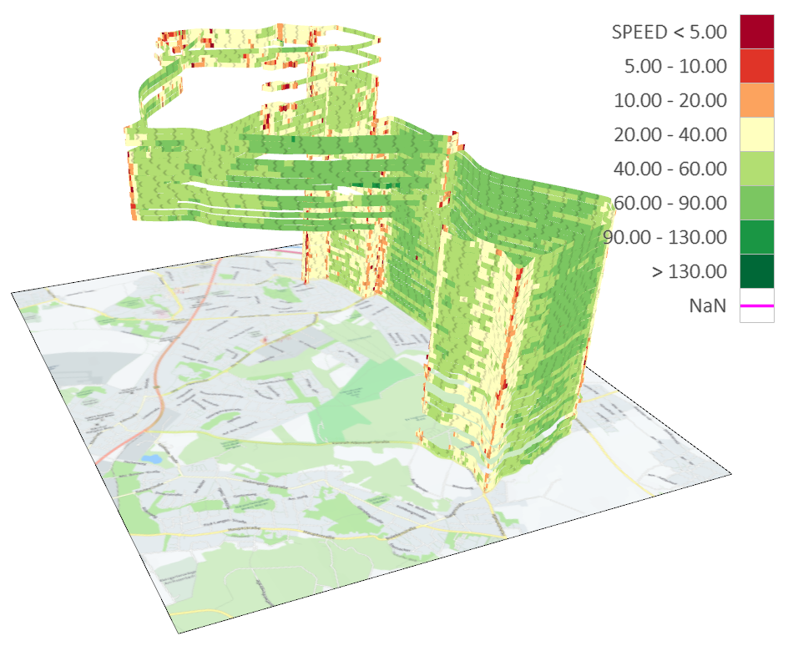
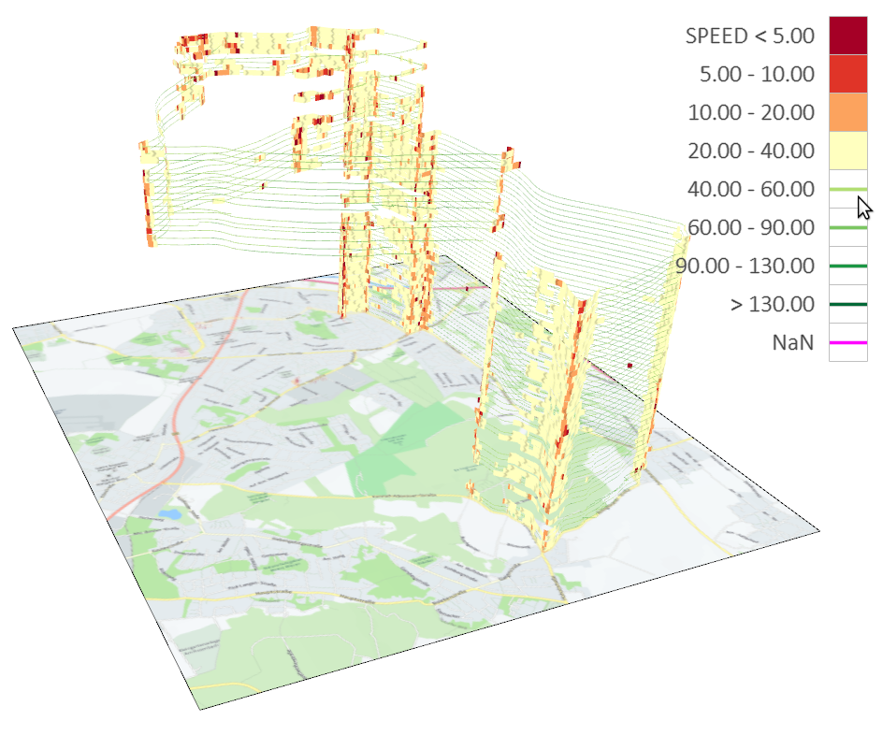
Interactive selection
Dynamic querying
Interactive legends
Problem: How to focus on low-speed segments?
Solution: Utilize the legend to filter out high-speeds!

Slide 18
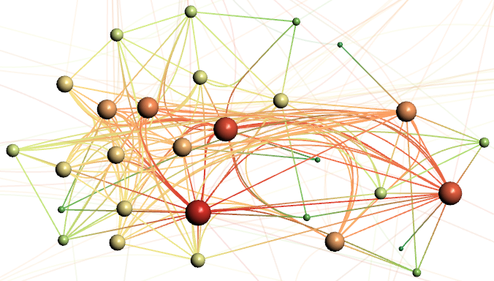
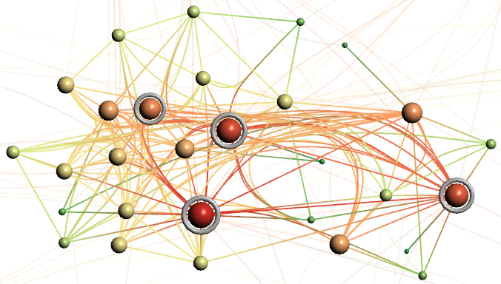


Interactive selection
Dynamic querying
Query sliders
Problem: How to focus on high-degree nodes?
Solution: Utilize query slider to mark high-degree nodes!

Slide 19
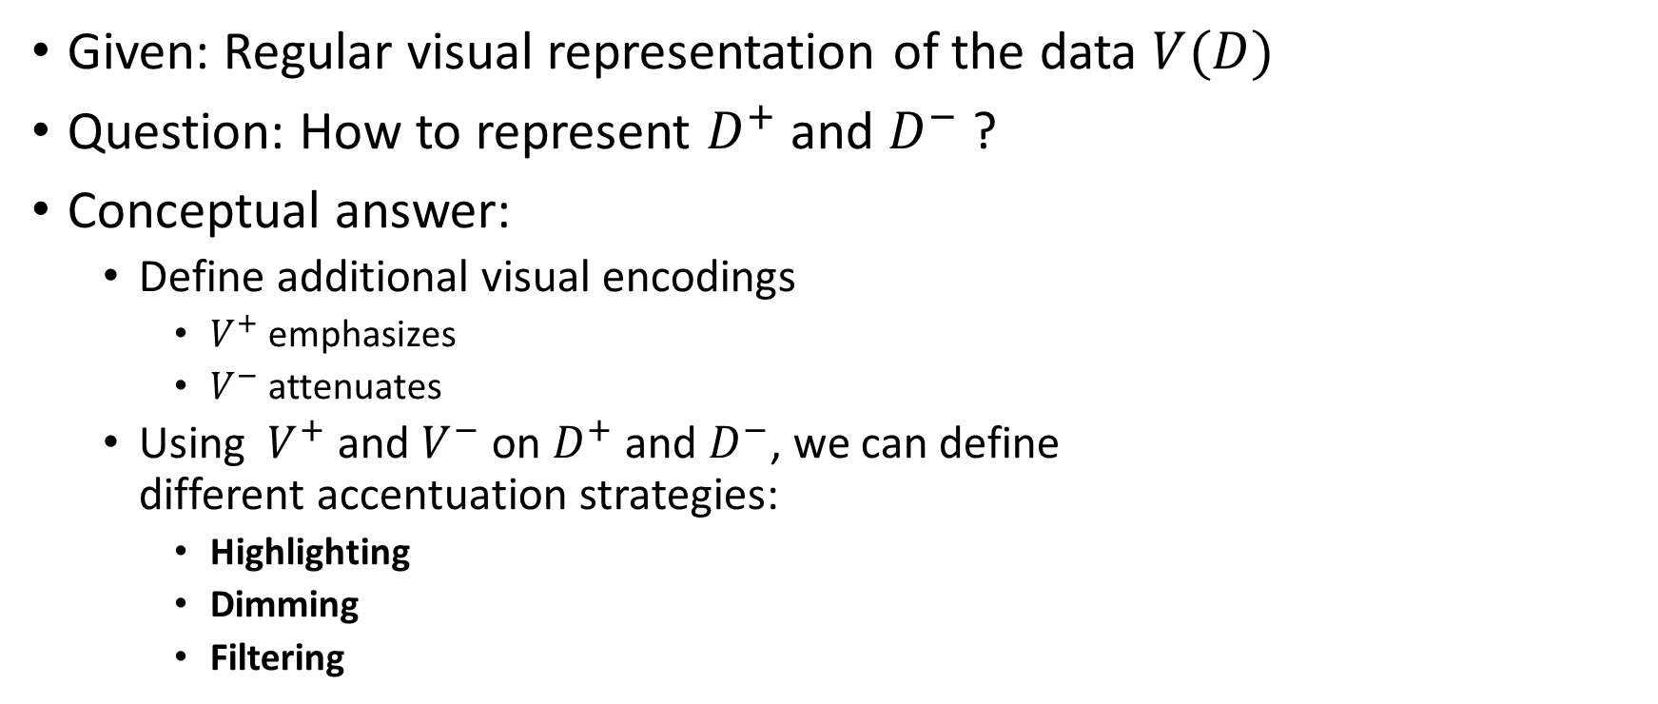
Accentuation
Given: Regular visual representation of the data $V(D)$
Question: How to represent $D^{+}$ and $D^{−}$ ?
Conceptual answer:
  Define additional visual encodings
    $V^{+}$ emphasizes
    $V^{−}$ attenuates
  Using $V^{+}$ and $V^{−}$ on $D^{+}$ and $D^{−}$, we can define
  different accentuation strategies:
    Highlighting
    Dimming
    Filtering

Slide 20

Accentuation
Highlighting: $V^{+}\left(D^{+}\right)+V(D)$
  Emphasize relevant data
  Regular display of less-relevant data
Dimming: $V\left(D^{+}\right)+V^{−}(D^{−})$
  Regular display of relevant data
  Attenuate less-relevant data
Filtering: $V\left(D^{+}\right)$
  Regular display of relevant data
  Omit all other data

Slide 21
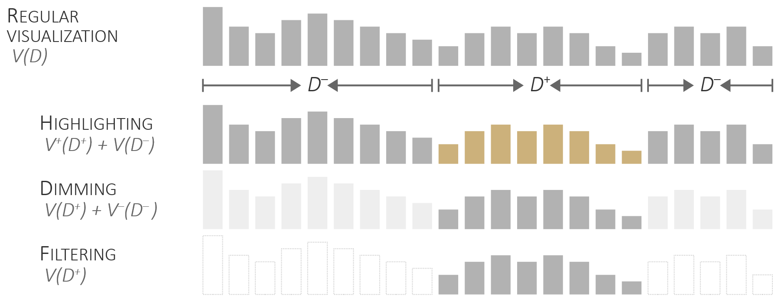
Accentuation

Slide 22
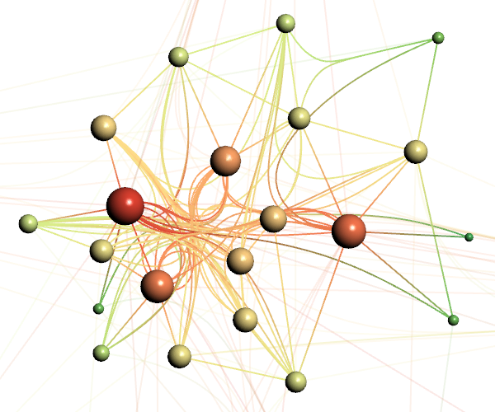
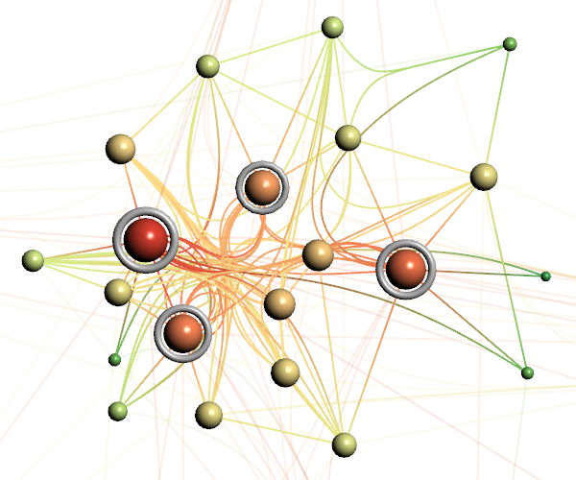
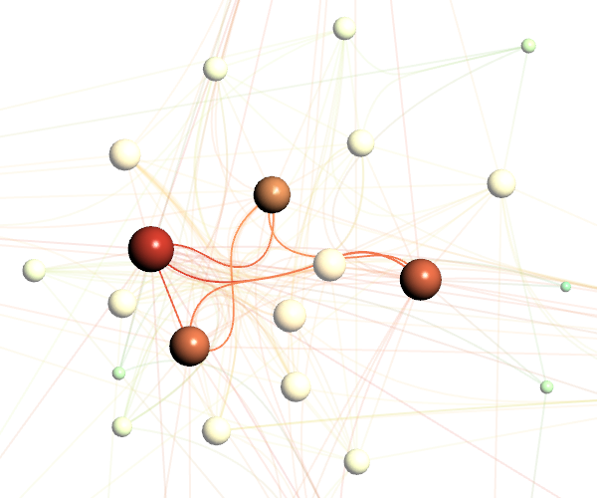
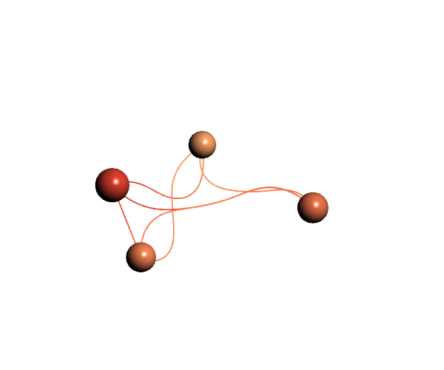
Accentuation
Regular encoding
Highlighting
Dimming
Filtering

Slide 23
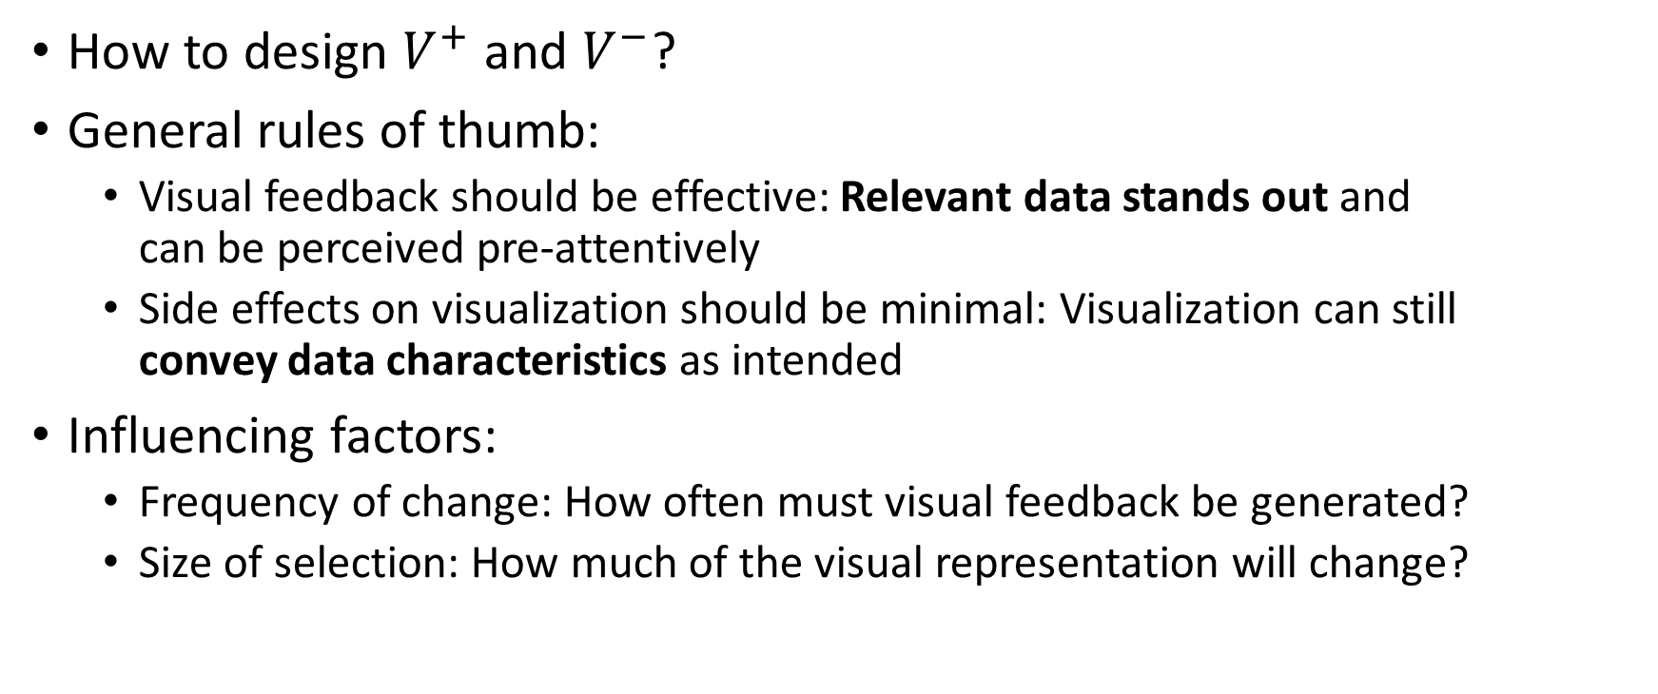
Accentuation
How to design $V^{+}$ and $V^{−}$?
General rules of thumb:
  Visual feedback should be effective: Relevant data stands out and
  can be perceived pre-attentively
  Side effects on visualization should be minimal: Visualization can still
  convey data characteristics as intended
Influencing factors:
  Frequency of change: How often must visual feedback be generated?
  Size of selection: How much of the visual representation will change?
We talked about pre-attentive processing in Lecture 4.

Slide 24
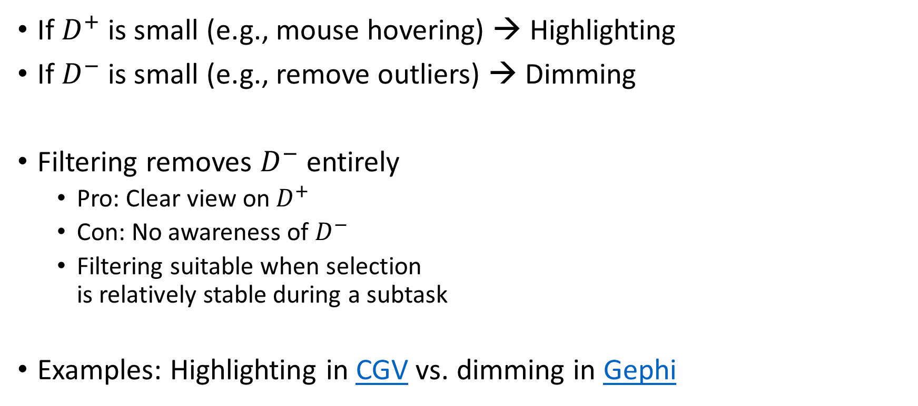
Accentuation
If $D^{+}$ is small (e.g., mouse hovering) → Highlighting
If $D^{−}$ is small (e.g., remove outliers) → Dimming
Filtering removes $D^{−}$ entirely
  Pro: Clear view on $D^{+}$
  Con: No awareness of $D^{−}$
  Filtering suitable when selection
  is relatively stable during a subtask
Examples: Highlighting in CGV vs. dimming in Gephi

Slide 25
Enhanced selection support
Smooth brushing
  Instead of binary-state selections,
  fuzzy selectedness in range [0,1]
Brushing & linking
  Selection in one view automatically
  propagated to all other views
Automatic selection support
  Auto-complete selections to reduce
  interaction costs

Slide 26
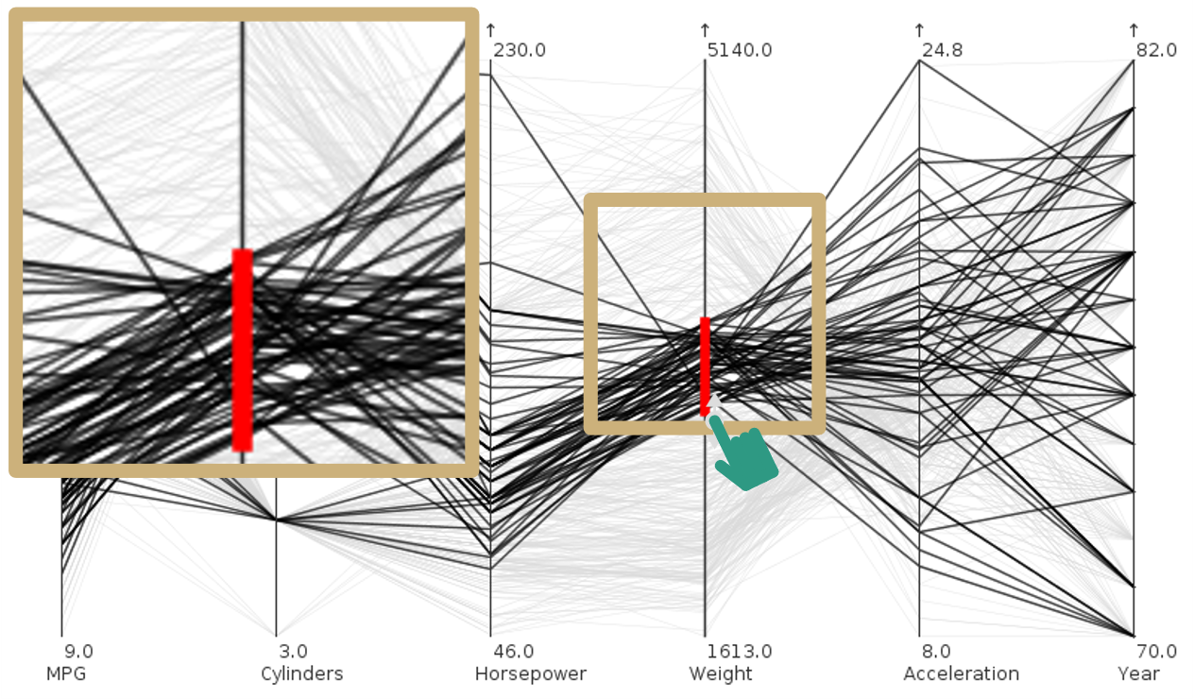
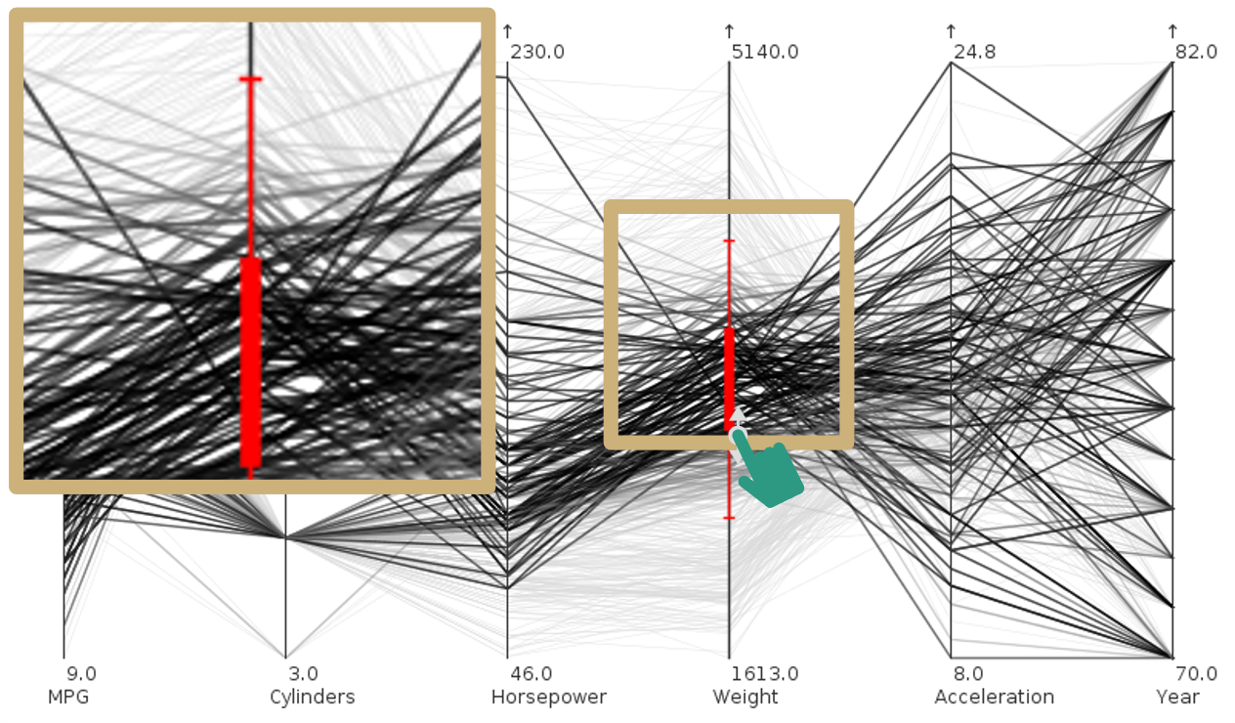
Enhanced selection support
Smooth brushing (Martin & Ward, 1995; Doleisch & Hauser, 2002)
Standard binary brushing
Enhanced smooth brushing

Slide 27
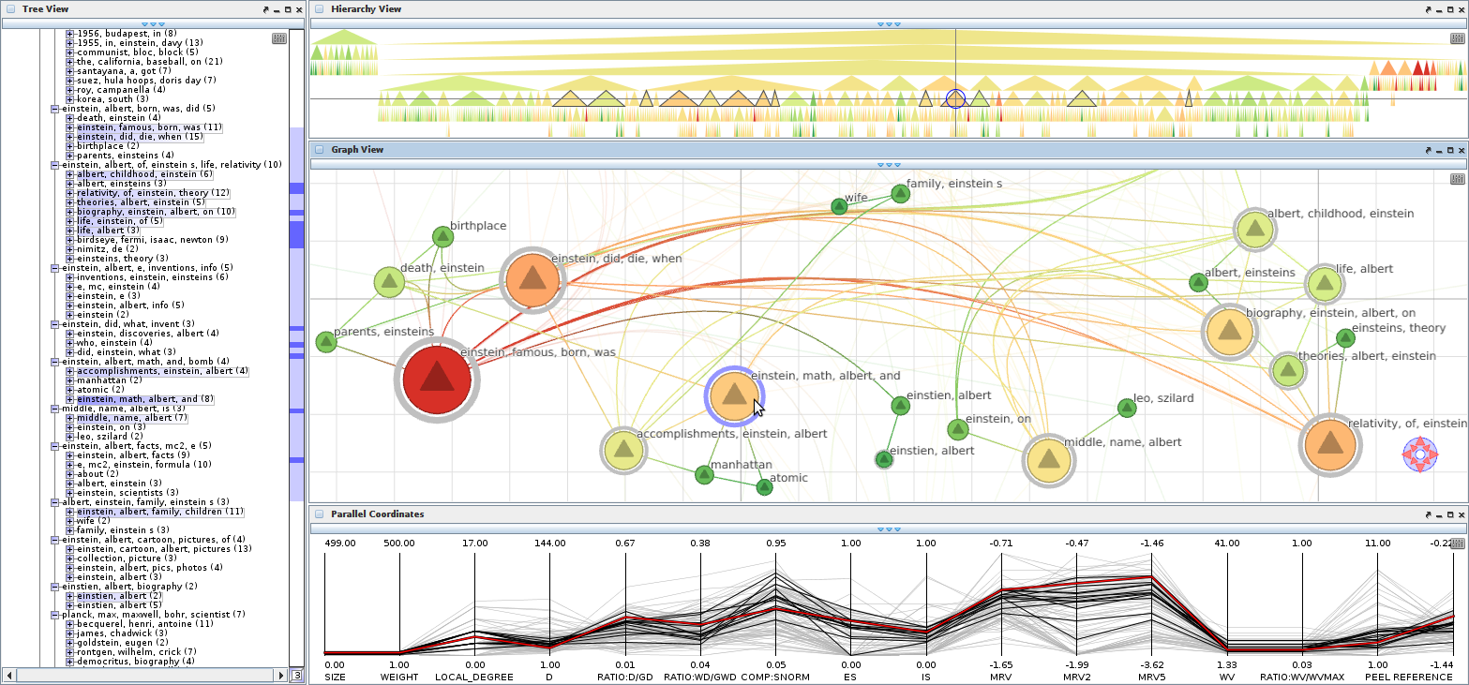
Enhanced selection support
Brushing & linking (Becker & Cleveland, 1987; Buja et al., 1991)
“
Multiple views, however, should not be regarded in isolation. They need to be linked so that the information contained in individual views can be integrated into a coherent image of the data as a whole.
— Buja et al., 1991

Slide 28
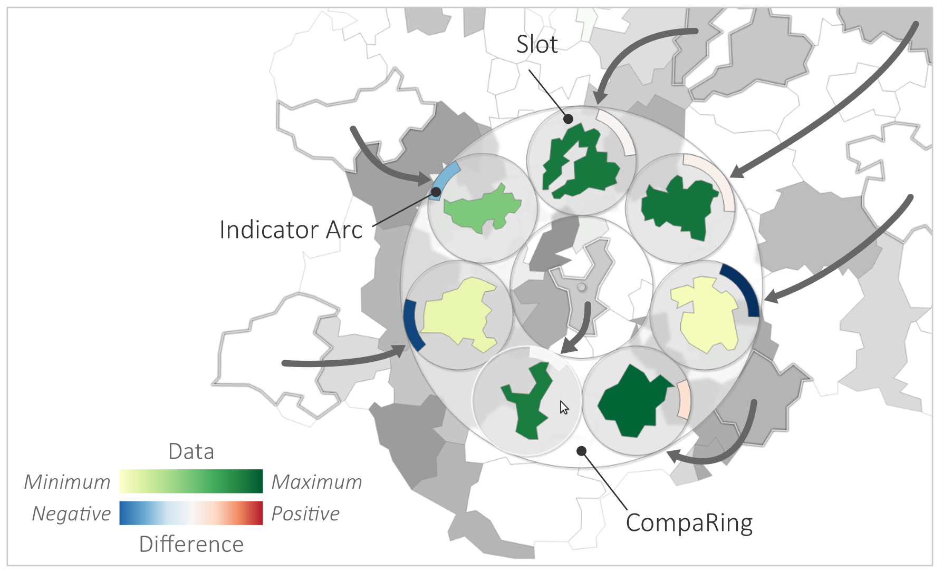
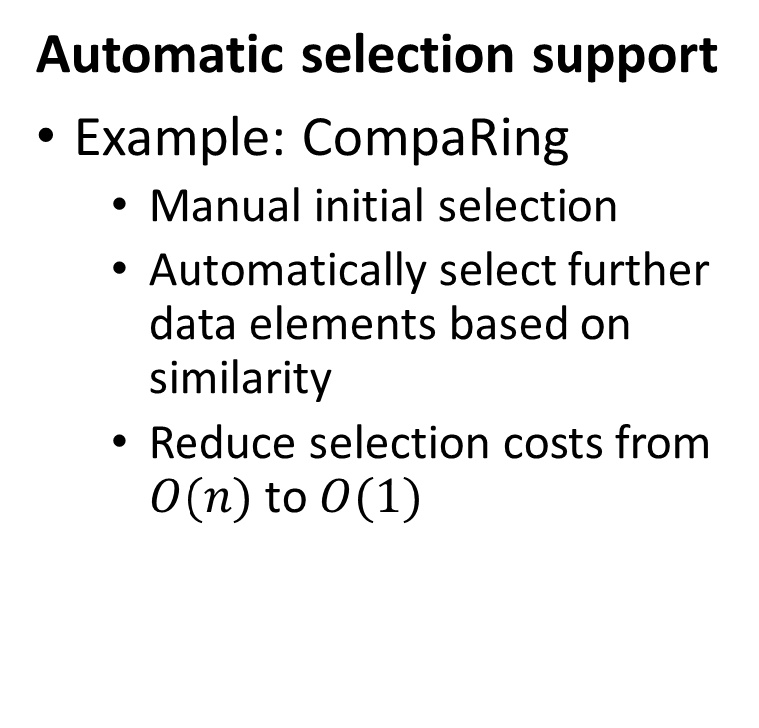
Enhanced selection support
Automatic selection support
Example: CompaRing
  Manual initial selection
  Automatically select further data elements based on similarity
  Reduce selection costs from $O(n)$ to $O(1)$

Slide 29
Outline
We finished:
Interactive selection and accentuation
  Mark something as interesting
  Show me something conditionally
Next we will be concerned with:
Navigating zoomable visualizations
  Show me something else
  Show me more or less detail

Slide 30
Navigating zoomable visualizations
How to navigate the data?
    Show me something else
    Show me more or less detail
Conceptual answer: Information seeking mantra
    Start with overview (big-picture, but no details)
    Zoom into subsets (details, but no overview)
    Return to overview and navigate to different
    subsets at different scales
    Repeat until satisfied
Practical answer: Zoomable interfaces (Bederson, 2011)
The information seeking mantra is fundamental in interactive visual data analysis!
“
Overview first, zoom and filter, then details-on-demand.
— Shneiderman, 1996

Slide 31
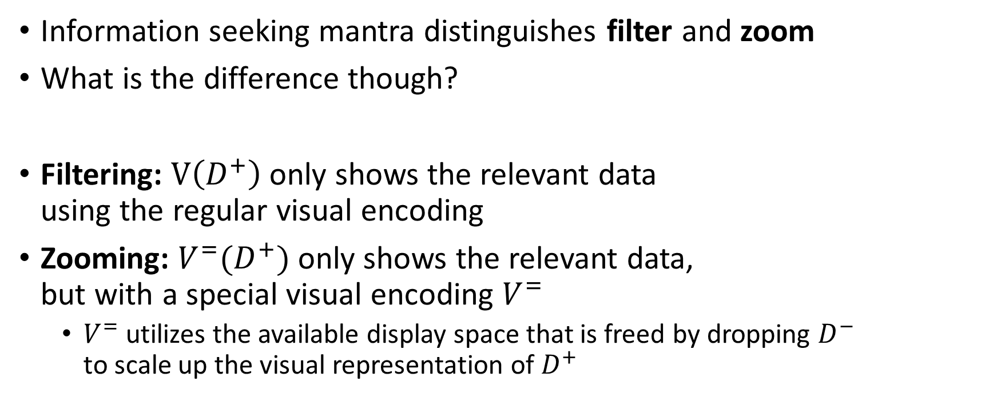
Navigating zoomable visualizations
Information seeking mantra distinguishes filter and zoom
What is the difference though?
Filtering: $V\left(D^{+}\right)$ only shows the relevant data
using the regular visual encoding
Zooming: $V^{=}(D^{+})$ only shows the relevant data,
but with a special visual encoding $V^{=}$
  $V^{=}$ utilizes the available display space that is freed by dropping $D^{−}$
  to scale up the visual representation of $D^{+}$

Slide 32
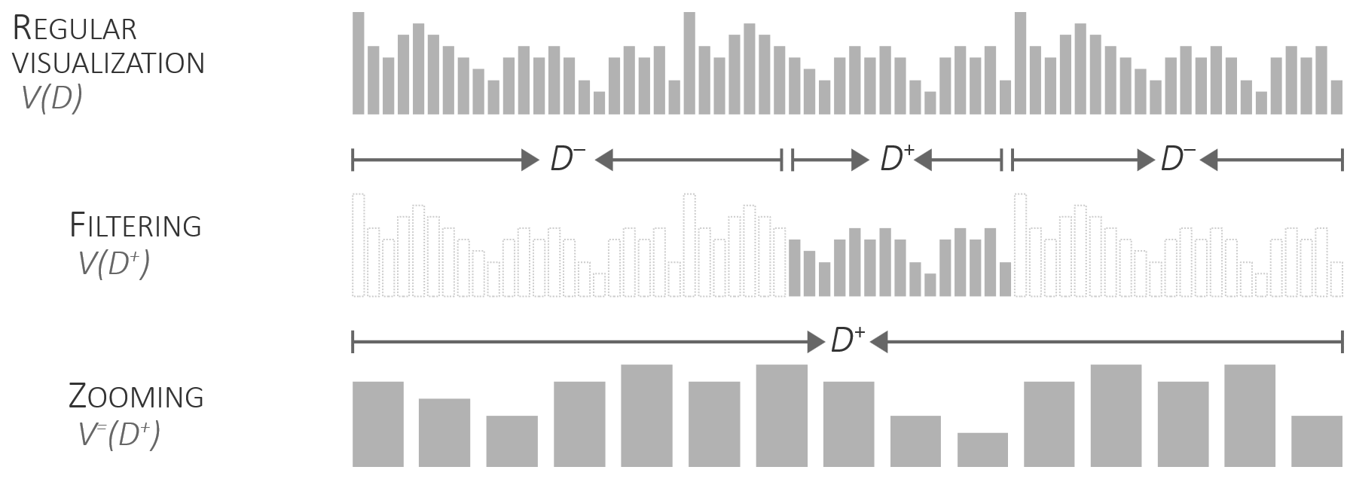
Navigating zoomable visualizations
Information seeking mantra distinguishes filter and zoom
What is the difference though?

Slide 33
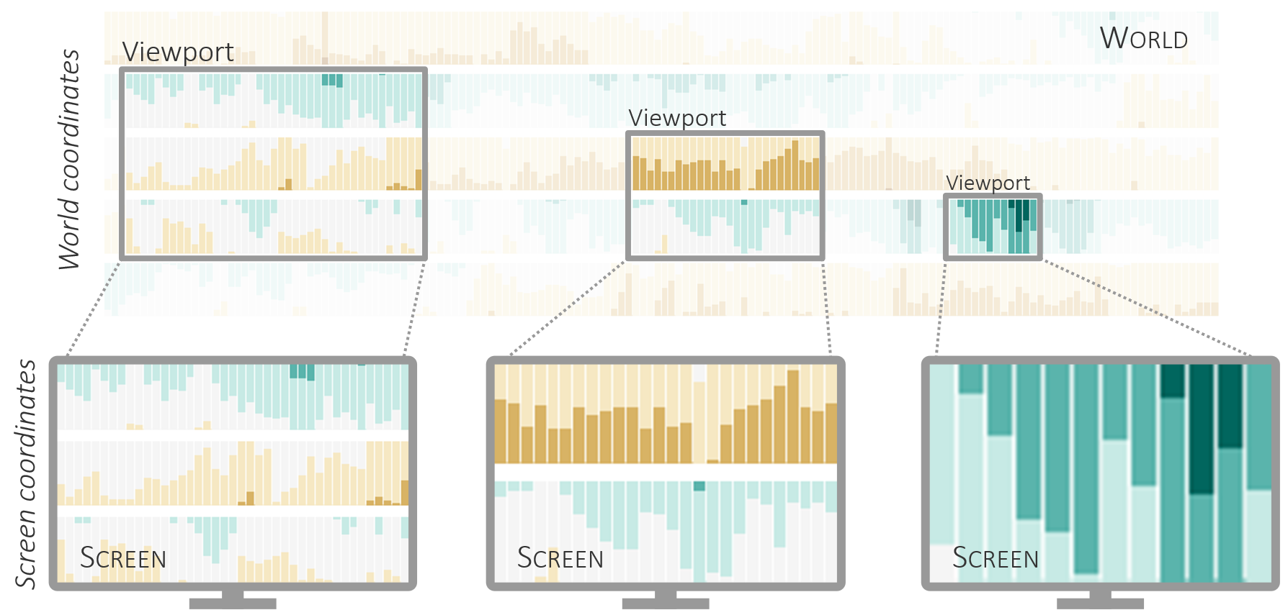
Navigating zoomable visualizations
Basic notions
  World: The space in
  which the visualization
  resides
  Viewport: The window
  through which the
  world is seen
  Screen: The display
  part onto which
  the view is projected

Slide 34
Navigating zoomable visualizations
// Viewport (left, top, width, height) in world coordinates
// Screen (0, 0, width, height) in screen coordinates
function project(viewport, screen, wx, wy) {
// Position in world (wx, wy) to position on screen (sx, sy)
let sx = (wx-viewport.left) * screen.width /viewport.width;
let sy = (wy-viewport.top) * screen.height/viewport.height;
return [sx, sy];
}
function unproject(viewport, screen, sx, sy) {
// Position on screen (sx, sy) to position in world (wx, wy)
let wx = viewport.left + sx * viewport.width /screen.width;
let wy = viewport.top + sy * viewport.height/screen.height;
return [wx, wy];
}
Basic mapping
  World coordinates are
  projected to screen
  coordinates depending
  on the viewport
  Screen coordinates can
  be un-projected to world
  coordinates also depending
  on the viewport

Slide 35
Navigating zoomable visualizations
Basic interactions
  Move viewport
    Change which part of the world is seen
  Resize viewport
    Adjust at what scale the world is seen
    Smaller viewport → Larger zoom
    Larger viewport → Smaller zoom
Basic visual feedback
  Geometric zooming
    Purely geometric scaling of visual representation
  Semantic zooming
    Any kind of adjustment of the visualization
Move
Move
Resize
Resize
Resize

Slide 36
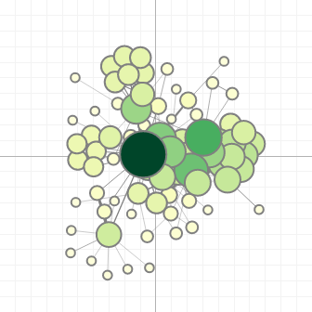
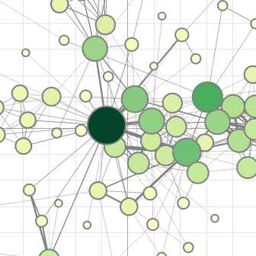
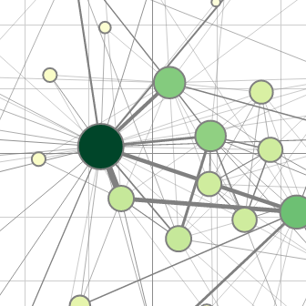
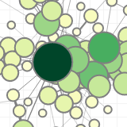

Navigating zoomable visualizations
Semantic zooming
Think about: Which
row shows
  Geometric zooming?
  Semantic zooming?
Think about: What
is semantic in this
example?
Geometric zooming

Slide 37
Navigating zoomable visualizations
Basics of zooming are clear now
Open question: How does the interface look like?
Visual interface must support users in coping with three questions:
  Where am I?
  → Indicate where in the world the current viewport is located
  Where can I go?
  → Indicate what is not covered by the current viewport
  How do I get there?
  → Provide interactions to define the viewport

Slide 38
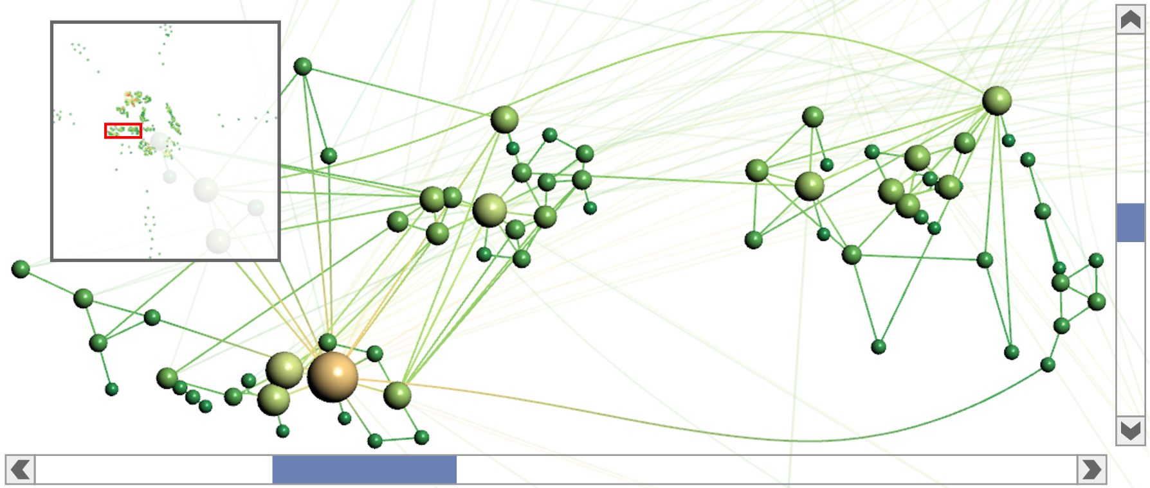
Navigating zoomable visualizations
Recall the overview + detail concept from Lecture 4.
Detail view
Think about: How are ‘Where am I?’ and ‘Where can I go?’ supported?
Overview
Scrollbars

Slide 39
Navigating zoomable visualizations
How do I get there?
Three operations: Move, scale, or define new viewport
  Direct interaction on the view
    Move view: Drag world in view (aka. panning)
    Scale view: Mouse wheel, mouse drag, or pinch gesture on view
    Define view: Draw elastic rectangle in view
  Manipulation of interface objects
    Move view: Drag scrollbars or viewport (red frame) in overview
    Scale view: Drag edges of scrollbars or border of viewport (red frame) in overview
    Define view: Draw elastic rectangle in overview
Think about: What are benefits and drawbacks of the two options
Notes:
Direct interaction
Good for small relative changes (can specify them precisely)
Not good for large navigation steps (would require many repetitive operations)
Not possible: Define new viewport that is larger than the current one
Interface objects
Good for large navigation steps (absolute access to entire world)
Not good for precise adjustments (interaction in relatively little display space)

Slide 40
Navigating zoomable visualizations
  So far, our zoom navigation is based purely on the visual layout of the data
  For example, panning a graph will bring us to nodes that are spatially near
  However, what about navigating to nodes that are “near” wrt. to the graph structure or “similar” in terms of node attributes?
Additional support needed: Interaction aids and visual cues
  Off-screen visualization: Show (selected) information that is currently off-screen
  Navigation shortcuts: Enable quick and effortless navigation to distant targets
  Animated view transitions: Make view changes understandable

Slide 41
Interaction aids and visual cues
Off-screen visualization
Focus+context approach to hint at subset of off-screen data
Two-step procedure
  Determine subset of data of interest to be hinted at
  Embed visual cues to indicate
    Where: Direction + distance where data are located
    What: Attribute values of data elements
    Why: Relevance of data elements

Slide 42
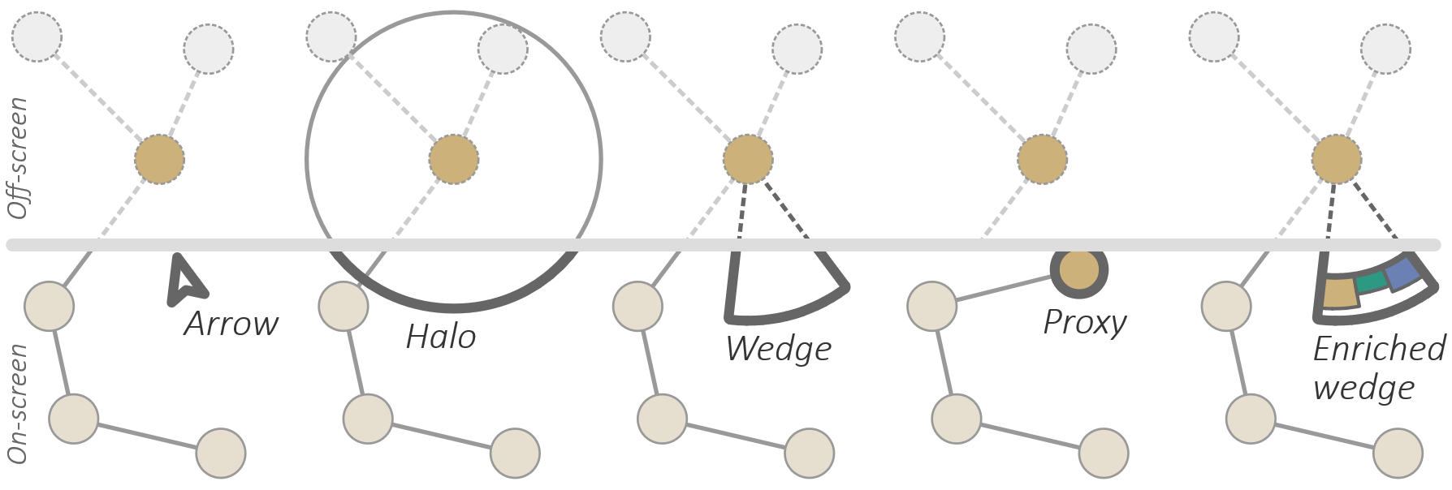
Interaction aids and visual cues
Off-screen visualization
  Examples of off-screen visualization techniques
  Think about: What can the individual techniques convey (where, what, why)?

Slide 43
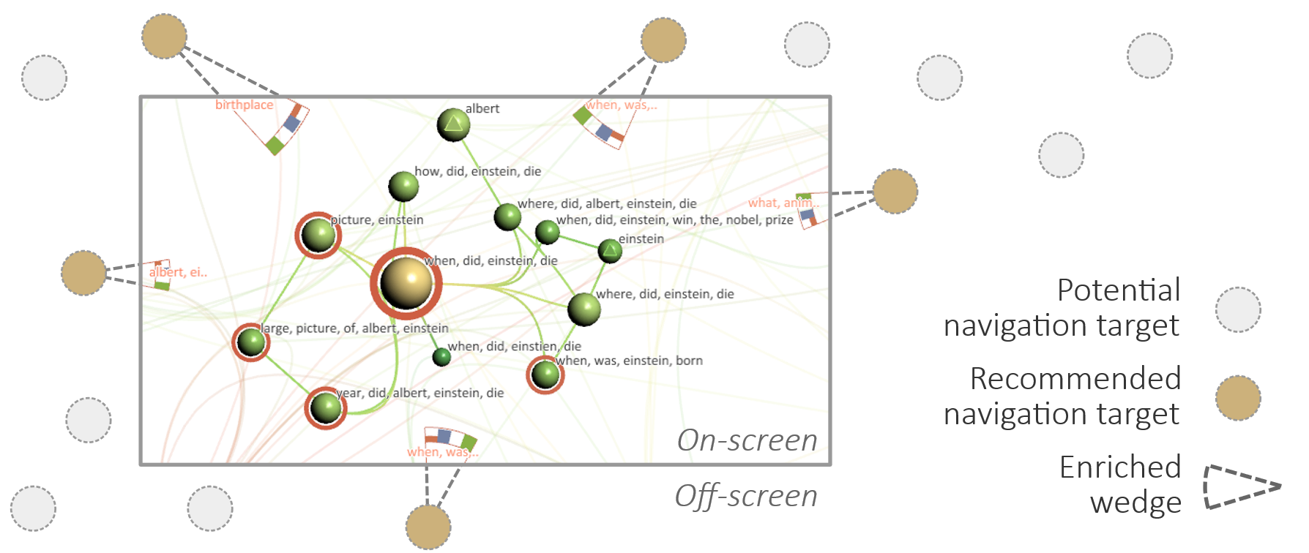
Interaction aids and visual cues
Off-screen visualization
  Navigation recommendations for graph exploration (Gladisch et al., 2013)

Slide 44
Interaction aids and visual cues
  Off-screen visualization helps us see where interesting data are located, but how to get there? Manual navigation works, but can be costly for longer distances.
  Better solution:
Navigation shortcuts
Enable quick and effortless navigation to distant targets
Shortcut defined by
  Target (data elements)
  Viewport (usually centered on target and large enough to include some context)
  Visual representation of shortcut (utilize visual cues for off-screen visualization)

Slide 45
Interaction aids and visual cues
Navigation shortcuts
Combine off-screen vis. and nav. shortcuts
→ Bring & Go (Moscovich et al., 2010 and Tominski et al., 2010)
Bring
  Arrange off-screen data of interest so that they are visible
Go
  Enable direct navigation to the data’s original location in the visualization

Slide 46
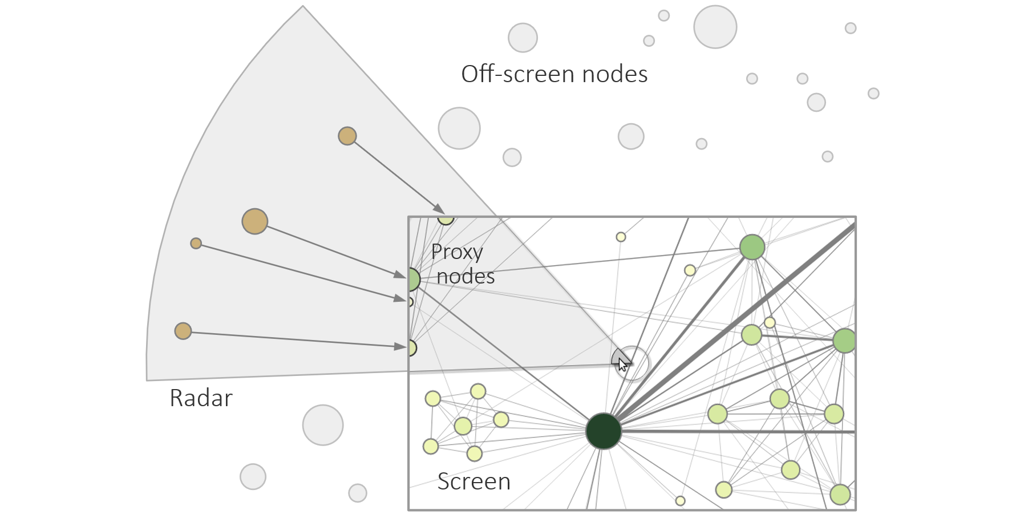
Interaction aids and visual cues
Navigation shortcuts
  Bring & go example: Radar view (Tominski et al., 2010)

Slide 47
Interaction aids and visual cues
Navigation shortcuts
With navigation shortcuts, we can now easily cover larger distances
But what type of visual feedback should we offer?
  Static feedback: Instantaneous switch to new viewport
  Animated feedback: Smooth transition from current to new viewport
  Think about: What are pros and cons of the two options for viewport changes?
Animated feedback would be helpful,
but how to animate viewport changes?
We introduced these two types of visual feedback in Lecture 9.
Notes:
Static feedback
Consumes no extra time
Navigation step may be difficult to comprehend (what did just happen?)
Easy to implement
Animated feedback
Navigation step is comprehensible
Requires extra time to see the animation
Additional implementation effort required

Slide 48
Interaction aids and visual cues
Animated view transitions
Naïve approach: Default timed animation
  Interpolate between current viewport and new viewport
  May include easing functions
  Drawbacks
    No consideration of the distinct meanings of viewport size (scale) and viewport position
    No consideration of the distance covered by the viewport change
Better approach: Dedicated smooth and efficient viewport animation

Slide 49
Interaction aids and visual cues
Animated view transitions
Smooth and efficient viewport animation (van Wijk & Nuij, 2004)
Three steps
  Zoom out from current viewport
  Pan toward new viewport
  Zoom in on new viewport
Instead of taking one step after the other, they are smoothly intertwined
Optimizing the animation interpolation involves non-trivial math

Slide 50
Interaction aids and visual cues
Animated view transitions
Smooth and efficient viewport animation (van Wijk & Nuij, 2004)

Slide 51
Interaction aids and visual cues
function Interpolator(orig, dest) {
let dx = dest.cx-orig.cx, dy = dest.cy-orig.cy; // Distance
let d2 = dx*dx + dy*dy, d = Math.sqrt(d2); // orig to dest
let u0 = 0, w0 = orig.w; // Interpolate between u0, w0
let u1 = d, w1 = dest.w; // and u1, w1 in u-w space
let S, i = {}; // Curve length S and interpolator object i
if (d > 1e-6) { // Regular case
let b0 = (w1*w1 - w0*w0 + rho4 * d2) / (2 * w0 * rho2 * d);
let b1 = (w1*w1 - w0*w0 - rho4 * d2) / (2 * w1 * rho2 * d);
let r0 = Math.log(Math.sqrt(b0*b0 + 1) - b0);
let r1 = Math.log(Math.sqrt(b1*b1 + 1) - b1);
let cr0 = Math.cosh(r0);
let sr0 = Math.sinh(r0);
S = (r1 - r0) / rho; // Curve length in u-w space
i.interpolate = function (t) { // Regular case interpolation
let s = t * S;
let u = w0 / (rho2*d) * (cr0*Math.tanh(rho*s + r0) - sr0);
return { // Return new viewport
cx: orig.cx + u * dx,
cy: orig.cy + u * dy,
w: w0 * cr0 / Math.cosh(rho * s + r0)
};
}
} else { // Special case
...
}
i.duration = S / V * 1000; // Depends on curve length and speed
return i;
}
Animated view transitions
  Smooth and efficient
  viewport animation
  (van Wijk & Nuij, 2004)
let V = 1.0; // Controls the speed of the animation
let rho = 1.565; // Controls the ratio of zooming and panning
let rho2 = rho*rho, rho4 = rho2*rho2;
} else { // Special case
let k = (w1 < w0) ? -1 : 1;
// Curve length depends only on w0 and w1
S = Math.abs(Math.log(w1 / w0)) / rho;
i.interpolate = function (t) { // Special case interpolation
let s = t * S;
return { // Return new viewport
cx: orig.cx + t * dx,
cy: orig.cy + t * dy,
w: w0 * Math.exp(k * rho * s)
};
}
}

Slide 52
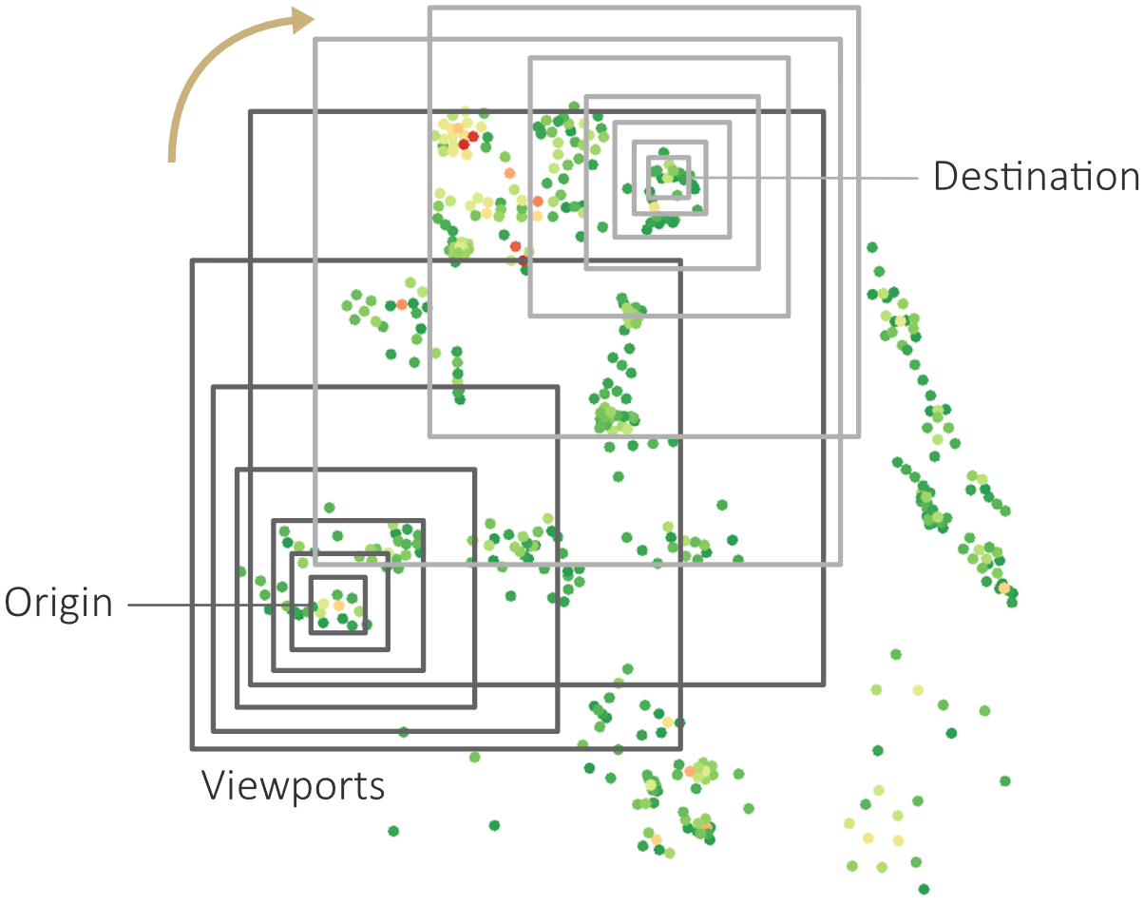
Interaction aids and visual cues
Animated view transitions
  Smooth and efficient
  viewport animation
  (van Wijk & Nuij, 2004)

Slide 53
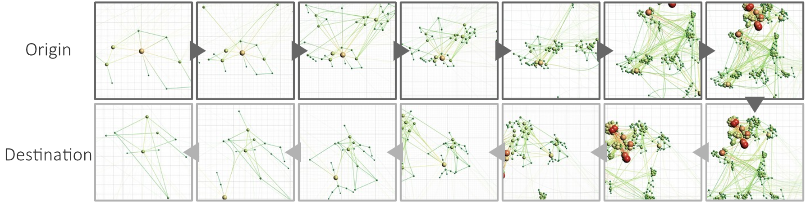
Interaction aids and visual cues
Animated view transitions
  Smooth and efficient viewport animation (van Wijk & Nuij, 2004)

Slide 54
Summary
Basic interaction techniques to
  Picking, selection, accentuation
    Mark something as interesting
    Show me something conditionally
  Zooming
    Show me something else
    Show me more or less detail

Slide 55
Assignments
Read about “The promise of zoomable user interfaces” by Ben Bederson!
Read about “Effective view navigation” by George Furnas!

Slide 56
Questions
What are the basic steps of pixel picking?
What is the computational complexity of geometry picking?
How can interactive selection and accentuation be modeled conceptually?
With respect to what characteristics do interactive brushing and dynamic querying select data?
Explain the difference between highlighting, dimming, and filtering!
What are the specifics of smooth brushing?
In what context is brushing & linking relevant?
How are the world, the viewport, and the screen related in zoomable interfaces?
What is semantic zooming?
What is off-screen visualization?
What is the basic idea of bring & go?
Indicate the three intertwined steps for smooth viewport animation!

